Slide 1
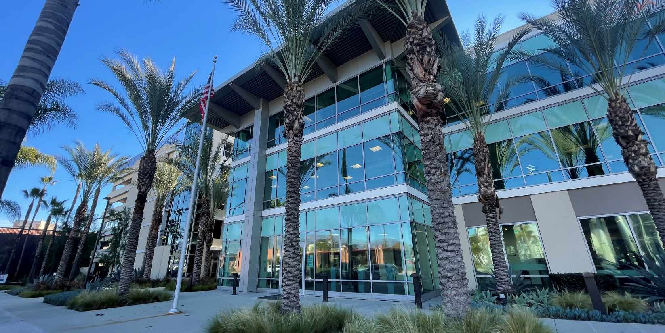
Community Development Block Grant (CDBG) Best Practices Working with
Other City/County Departments
National Community Development Association 55th Annual Conference
Cambridge, MA
June 12, 2024

Slide 2
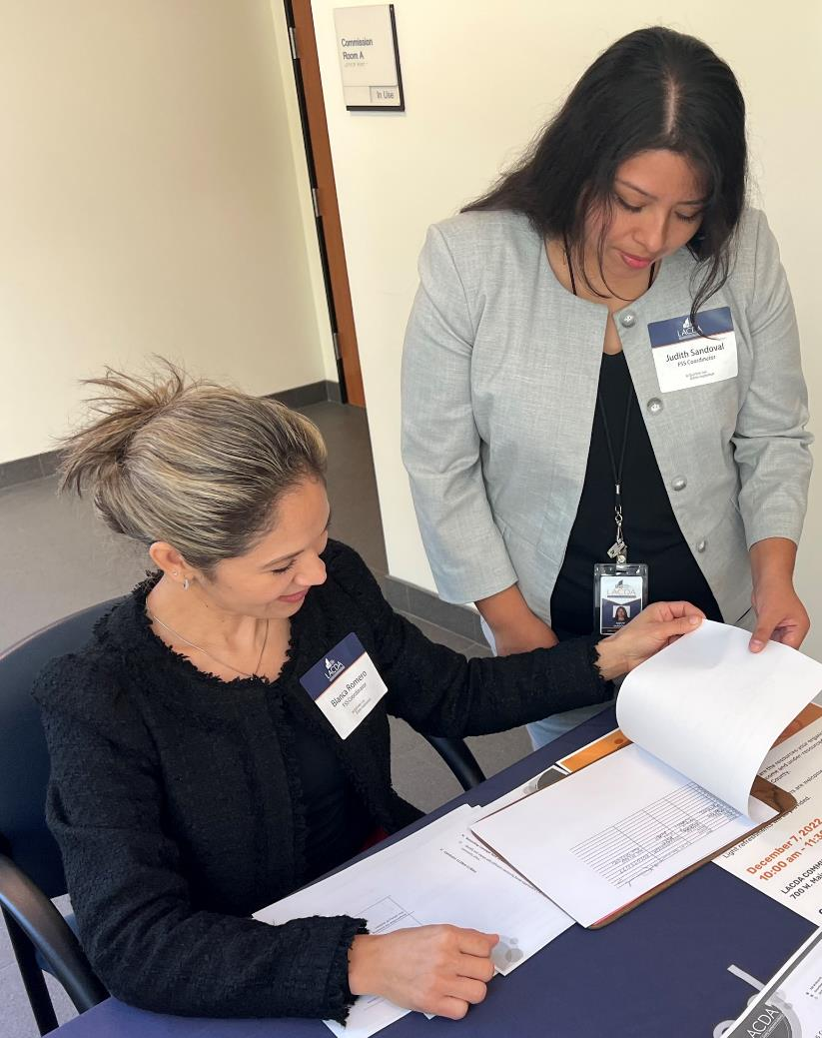
Overview
Timeliness Performance
Agenda
Contract Manager Perspective
Management Perspective
Down to the Wire
Lessons Learned

Slide 3
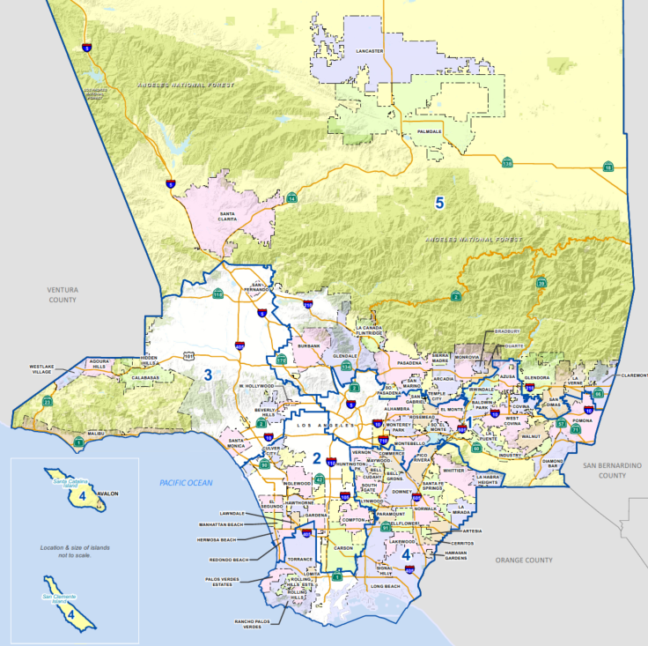
Overview
Los Angeles Urban County CDBG Entitlement Jurisdiction since 1974
Participating Cities
Community-Based Organizations
County Departments
Internal Departments
Notes:
Population of LA County 10 Million
Geographic Size
Participating Cities 48
CBOs – 24
County Depts -6
HIF, HOD, CMD

Slide 6
Notes:
Implemented CDBG programs on behalf of Agencies (Due to Covid)
*Timeliness Score?
Public service Cap “reinstated”
Capital Improvements / Housing Rehab
Supply Chain
Labor/Expertise
Energy focused on CV – Timelimited.

Slide 7
Contract Manager Perspective
Early Technical Assistance
Projection Submission
In-Progress Monitoring
Partnership with Subrecipients
Notes:
Thanks, Jo Ann. Good afternoon, I’m Vanessa Estella, a contract manager whose primary role is as liaison between Los Angeles County and CDBG subrecipients. I assist cities with their CDBG planning, implementation, compliance/monitoring and closeout. From my perspective of working directly with cities on the timeliness ratio requirement, 4 best practices easily come to mind.
The first one is
Early Technical Assistance: Once it was determined in May that the County did not pass the timeliness test, my colleagues and I worked immediately with our subrecipients on providing Technical Assistance. We met will all our assigned cities, but we paid special attention to those cities that would be on Work-Out Plan for failing to meet their spend-down requirement. TA focused on identifying and resolving those issues that prevented cities from spending money in a timely way. We looked at several strategies, from amending budgets of inactive programs and moving them to active programs (for example, increasing budgets of residential rehab programs); brainstorming ‘shovel-ready’ projects. One that came to mind was ADA door replacement project or a signage project in an LMA city; and completing the environmental service reviews for construction projects early and revisiting construction timelines to make they were current and feasible; the County has a county-wide program called Shelter Partnership which serves unhoused populations throughout the county. Cities were presented the option to designate their funds to this program. The point was to get subrecipients to re-evaluate their current programs and to take immediate action with the goal of spending down for the remainder of the year. Secondly, another best practice would be Projection Submission:
As part of their Workout Plan, cities submitted monthly projections of expenditures. The Work-Out Plan identified projects to target, tracked the expenditures, and provided deadlines. Contract managers then followed-up when those projections were not met.
Also each month, Contract Managers used our system tracking reports of expenditures and accomplishments to analyze where are cities landed with their spending goals. We also looked at quarterly performance reports to analyze accomplishments and expenses. We kept their drawdown numbers in front of them regularly so they could see how their programs were performing.
I would add that being on a Workout Plan required some adjusting of the mind-set of cities. For example, if they typically submitted a FR or reimbursement quarterly, we had to get them to re-think that habit and do it monthly. Or if some projects since the pandemic were spending less that their original budgets, we asked cities to consider reprogramming those funds. For example, youth afterschool program funded at $20k since pre-Covid, but never quite picked up again. The city convinced their City Council to approve moving funds into an active senior program. A next best practice is
In-Progress Monitoring: This refers to the County’s annual financial and programmatic monitoring for compliance. The monitoring results basically served as another resource for us to gather performance data and make assessments of how cities were spending. And a final best practice would be building strong
Partnerships with Subrecipients
The County’s ability to meet the timeliness ratio is wholly dependent on the cities. As a contract manager, I leaned on my counterparts in the cities to get us to our goal. This required regular phone calls, check-in meetings, and emails containing performance data. This was followed by even more communication to impart urgency to spend funds.
Ultimately, it was about tapping those connections with City staff that have been fostered over time. Jo Ann will now share her perspective from the Management side.

Slide 8
May 2023
Sep 2023
Mar 2024
Dec 2023
Jan 2024
Aug 2023
Management Perspective
Identify Non-compliant Activities & Develop a Strategy for Change
Realistic Analytics of the Project Expenditures
Analyze Quarterly Performance & Project Activity Drawdowns
Communications & Accountability
Communicate Vision & Obtain Buy-in from Stakeholders
Maintain a Positive Outlook & Recognize the Wins
Notes:
MAY/JUNE: Conduct Internal Audit of Activities; Identify Low Yield Agencies & Developed a Structured Work-Out Plan
AUG: Communicated the Vision & Strategy to ALL. Met with Contract Managers to review the Cities WOP responses & Discussed technical assistance strategies for the WOP
SEP: Reviewed the QPR results and honed in on public facilities projects- its timelines and encouraged a change in mind set towards implementation and monthly drawdowns.
DEC: Formal letters sent to City Managers, Exec Directors & Department Heads which provided evidence of low performance & expenditures Firm, No-nonsense level of expectation
JAN: Refining the initial analysis. Review current and past trends in submission of draws .Regain buy-in commitment
MAR: Monitor progress. Maintain a positive outlook, recognize individual achievements, maintain the Team's goal in constant sight for the BIG PUSH
APR: Remind partners of their commitments, checked our systems for inactivity/pending funding requests & DIGGING DEEP.
Management MindSet - None urgent April 2022
Look at tools in our System and analyze info; assist staff to hone in on projects with low percentages. Look at each jurisdiction using tools;
Example of tools – CSR (budget, timeframe, % of expenditure, HUD Code) - looking at these fields as a supervisor, looking at duration of project, then it should have expenditures. What's going on with project? Is it ready for FR; PS projects should expend funds quickly. Looking at projects with sizable budgets ($500k projects – where are they?). We started looking at this Aug/Sept after closeout and started strategizing
Incentives for staff. Everyone knew goal and aim.
Sending messages to staff. Often, consistent.
As a supervisor, trying to balance it with staff so they could see info. Seeing report each month.
Sent out monthly table with percentages of targets so everyone bought into it
Jan – regrouped. What did the % mean in terms of dollars.
Extra tool: QPR – checked quarterly. Each CM did overall review project-wise esp facilities improvements project. Where they are with timeline (explain QPR portal). CM's must approve each QPR.
Early on July/Aug, we identified who did not meet timeliness test, notified them, and put them on workout plan. Submit plan by end of May. Info was collected. Fall meetings with cities (CDBG primary) and then supervisor. We knew our strategy with working on low performers
Letters to city managers, community development directors
Notified districts as to which cities did not respond with workout plan
Jan/Feb - monthly CSRs were analyzed. Knowing the dollar target needed to be drawn; changed how we see goal from % to $. Pushing March deadline to submit.
March – checking numbers weekly; met with Bell Gardens, South El Monte, Laverne, Santa Fe Springs, San Marino, So Pasadena, emphasis on going to cities/ formal visits with city manager, upper level mgmt, consultants
Informing cities of the levers we could pull – recapture funds – in order to move funds into other projects like Shelter Partnership. Making cities realize there are consequences to not meeting timeliness
Relying on our timely performers to come through.
Set out performance letters (April/May 2023) Workoutplan
Evaluating Workout plan – review check in Sept 2023.
Cities Padding projects.
Reports Available ?
Funding request ? Pending invoices

Slide 9
Down to the Wire
Rally the Troops
Reflect Why the Goal Matters
Remain Focused and Motivated
Define the Success
Stay Present During the Crunch
Moments of Celebration
Notes:
Requesting agencies to submit monthly vs bi-monthly, which was their routine
Advance contract; did not requisition for several months. PACE – no FR since Dec. $410,000 submission.
Everyone look for $30k each (looked to agencies where we had good relationships).
FAB colleagues knew to finish by 2PM. Coordinated.
Last minute amendments to be able to submit FR. Maintained standards, no shortcuts, stay honest.
Denied requests for public service waivers from some agencies; put funds in escrow accounts; encumbered funds that city wanted reimbursement for but was not yet paid
Districts leveraged to encourage CBOs to meet timeliness requirement;

Slide 10
1.47
Notes:
Acknowledgment & recognition of staff accomplishments– CMs, FAB
Looking at Who didn't meet it; we don't want a repeat next March; taking inventory of who performed well and who did not
Recommendations: future funding thru district

Slide 11
Lessons Learned
1
Strengthening Policies and Procedures
2
Build System of Accountability
3
Growth Mind Set
4
Personal Approach
5
Identify Community Needs
Notes:
This next slide summarizes the lessons we learned in working toward passing the timeliness test.
Strengthening Policies and Procedures
While the pandemic compelled us to pivot from our usual practices, we realized that we needed to return to and reinforce our policies and procedures.
Build System of Accountability
Disseminating tracking reports to cities
Reviewing progress against the Work Out Plan projections
Sending letters to city officials about status of their CDBG programs and discussing consequences (loss of funds, sanctions, corrective actions)
Growth Mindset
Being consistent, persistent with our goal
Having an understanding of what works/ doesn’t work to reach the goal
Adapting to different practices to improve outcomes
Personal Approach
l Relationship building; open and regular communication; being responsive.
Identify Community Needs
Understanding the unique circumstances of each city; conducting “New Year’s calls” at the start of the fiscal year and re-connecting; having cities complete Planning Questionnaires; providing Technical Assistance

Slide 12
Questions

Slide 13
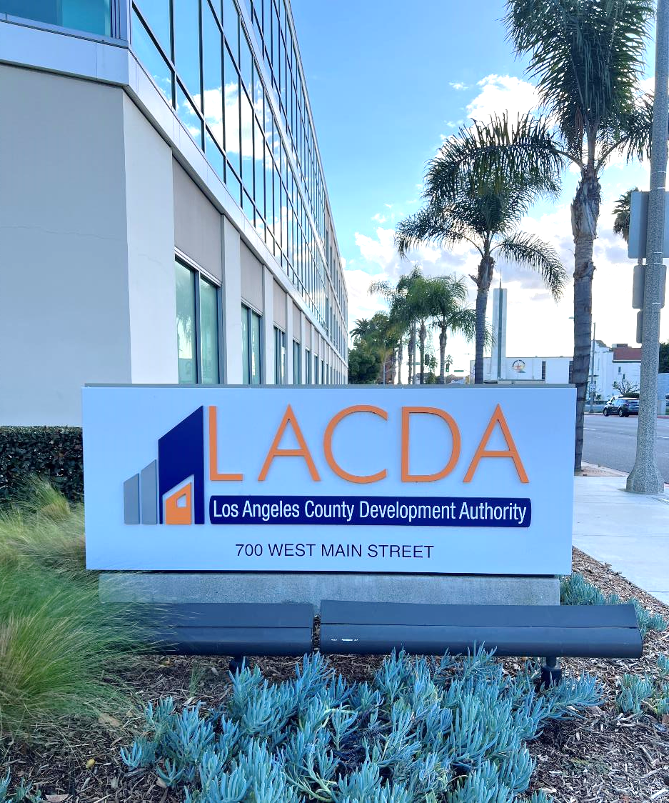
Contact Us
Jo Ann Delgado, Supervisor
(626) 586-1749
JoAnn.Eros@lacda.org
Vanessa Estella, Development Specialist
(626) 586-1508
Vanessa.Estella@lacda.org
Alhambra Office
700 West Main Street
Alhambra, CA 91801
626.262.4511
www.lacda.org

